Slide 1
Rotary 101 by Bill Downes (PDG 2016-2017)

Slide 2
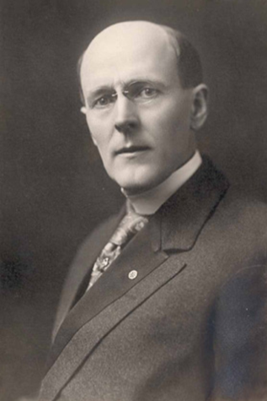
Why Rotary Needs You
This is a changing world,
we must be prepared to
change with it. The story of
Rotary will have to be written again and again!
Paul Harris, Founder of Rotary

Slide 3
Mission Statement
The Mission of Rotary International is to provide service to others,
promote integrity, and
advance world understanding, goodwill, and peace, through its fellowship of business, professional, and community leaders
Notes:
1914: Rotary throughout US, Canada, and British Isles
1914: England joined WWI, Canada, as a sovereignty, was involved, and US Rotarians felt they should support their brethren to the North. Converted busses to ambulances, took care of orphaned children, created jobs for returning Vets. Most importantly began looking at how they could prevent war.
1917: President Arch Klumph proposed setting up an endowment “For the purpose of doing good” Later became The Rotary (International) Foundation (TRF)
1921: Adoption of the fourth object of Rotary, which sets Rotary apart from any other service club.
1929: RIF first gift of $500 to an organization created by Rotarian Edgar Allen, later grew into Easter Seals
1930’s: Many Rotarian articles by Einstein, Schweitzer, H. G. Wells, G. B. Shaw around peace and “looking beyond derisive labels”.
1940: Convention in Havana, Cuba adopted resolution 40-15 stating: (Paraphrased) Rotary has no interest in your religion or politics of your country, but if you do not treat people with human rights, Rotary cannot operate there.
1942: London Rotary gathered leaders from 21 countries to discuss World Peace. The group continued to meet and later became United Nations Educational, Scientific, and Cultural Organization. (UNESCO)
1940-1944: During war Germany, Italy, and Spain banned Rotary. Many clubs continued as “singing Clubs” or “Day of the Week Clubs”: (re. Monday Noon Club, etc.) until after the war.
1945: Rotary invited to send 11 Rotarians in critical roles to help form UN. 47 Rotarians involved altogether.

Slide 4
Guiding Principles of Rotary
Four-Way Test
Code of Conduct
Five Avenues of Service
Object of Rotary

Slide 5
Guiding Principles of Rotary
The Four Way Test
Of the things we think, say, and do:
1) Is it the Truth?
2) Is it Fair to all Concerned?
3) Will it Build Goodwill and
Better Friendships?
4) Will it be Beneficial to all concerned
Notes:
Written by Herbert Taylor in 1932 upon his taking over a failing company, he believed that by his salesmen living these four simple truths it could change his company. It did. He gave the rights to it to Rotary International in 1942.

Slide 6
Guiding Principles of Rotary
Code of Conduct
1. Act with integrity and high ethical standards in my personal and professional life.
2. Deal fairly with others and treat them and their occupations with respect.
3. Use my professional skills through Rotary to mentor young people, help those with special needs, and improve people’s quality of life in my community and in the world.
4. Avoid behavior that reflects adversely on Rotary or other Rotarians.

Slide 7
Guiding Principles of Rotary
Rotary Clubs
Avenues of Service
1. Club Service
2. Community Service
3. International Service
4. Vocational Service
5. Youth Service
The Rotary Foundation
Areas of Focus
1. Promoting Peace
2. Disease Prevention
3. Water & Sanitation
4. Maternal/Child Health
5. Education/Literacy
6. Community Development
Notes:
This slide is created to help explain the difference between Avenues of Service (for clubs) and Areas of Focus for applying grants (for The Rotary Foundation).

Slide 8
Guiding Principles of Rotary
The Object of Rotary
Is to encourage and foster the ideal of service as a basis of worthy enterprise and, in particular, to encourage and foster:
Notes:
There are four Objects of Rotary and as many as six. They were consolidated in 1927 into what you see here. As you see it follows the main theme of what Rotary is all about.

Slide 9
Guiding Principles of Rotary
The Object of Rotary
First. The development of acquaintance as an opportunity for service.
Second. High ethical standards in business and professions, the recognition of the worthiness of all useful occupations as an opportunity to serve society.
Notes:
High Ethical Standards is one source of our strength, uniqueness, and longevity. We live it, teach it, and believe it.

Slide 10
Guiding Principles of Rotary
The Object of Rotary
Third. The application of the ideal of service in each Rotarian’s personal, business, and community life.
Fourth. The advancement of international understanding, goodwill, and peace through a world fellowship of business and professional persons united in the ideal of service
Notes:
As stated above the 4th Object of Rotary sets us apart from any other service organization. Whereas most other service organizations have the word “service” somewhere in their stated goals, none reach to this level. From this Object came the Youth Exchange in 1927, Friendship Exchange, VTT (formerly GSE) and many more developing international connections.

Slide 11
4th Object of Rotary
Advance World Understanding
Youth Exchange
Friendship Exchange
Vocational Training Teams
International Conventions

Slide 12
4th Object of Rotary
Advance Goodwill
A-Political
A-Religious
Gender Neutral
Sylvia Whitlock, first woman Rotarian
Rotary Action Groups
Rotary Fellowships
Notes:
Many failed attempts to bring in women over the years.
1982: Duarte, California Club inducted Sylvia Whitlock, lost charter, sued, 1987 Supreme Court ruled Rotary could not discriminate by gender. Club was reinstated. First women in Rotary: Sylvia Whitlock, club President, 1987, District Governor, 2014-15, district 5300.

Slide 13
4th Object of Rotary
Advance Peace
UNESCO
UN
Peace Scholars
Peace Centers
Rotary Action Group for Peace
Notes:
1997: in honor of the 50th anniversary of the death Paul Harris it was decided to establish a peace school. Peace had been a mantra of Paul since the beginning of Rotary.
1999: Six Peace Schools in six different countries were established along with the Peace Fellowship Program by The Rotary Foundation.

Slide 14
4th Object of Rotary
Through Fellowship
Regular Rotary Meetings
Social gatherings/parties
District Conferences/events
International Conventions
Leadership Training

Slide 15
Structure of Rotary
Rotary Clubs
Districts
Zones
RI
35,764
529
34
1
Notes:
There are approximately 1.2 million Rotarians in the world in over 200 countries.
Rotary is the largest service organization in the world outside of the Red Cross.
The number of clubs and districts as reported by RI Support will vary from time to time. Zones are set.
Districts have a minimum of 1,100 members. Above 5,000 they may be split into two.
Typically 40-70 clubs
Zones always remain at 34 worldwide and are balanced every 8 years by total numbers as much as possible (31,000-37,000 Rotarians).
Zones serve as a training base for incoming District Governors and other District leaders. It also serves as a voting base for RI President.

Slide 17
Mountain Foothills RC Projects

Slide 18
Structure of Rotary
Rotary Clubs
Districts
Zones
RI
35,764
529
34
1
Notes:
There are approximately 1.2 million Rotarians in the world in over 200 countries.
Rotary is the largest service organization in the world outside of the Red Cross.
The number of clubs and districts as reported by RI Support will vary from time to time. Zones are set.
Districts have a minimum of 1,100 members. Above 5,000 they may be split into two.
Typically 40-70 clubs
Zones always remain at 34 worldwide and are balanced every 8 years by total numbers as much as possible (31,000-37,000 Rotarians).
Zones serve as a training base for incoming District Governors and other District leaders. It also serves as a voting base for RI President.

Slide 21
Structure of Rotary
Rotary Clubs
Districts
Zones
RI
35,764
529
34
1
Notes:
There are approximately 1.2 million Rotarians in the world in over 200 countries.
Rotary is the largest service organization in the world outside of the Red Cross.
The number of clubs and districts as reported by RI Support will vary from time to time. Zones are set.
Districts have a minimum of 1,100 members. Above 5,000 they may be split into two.
Typically 40-70 clubs
Zones always remain at 34 worldwide and are balanced every 8 years by total numbers as much as possible (31,000-37,000 Rotarians).
Zones serve as a training base for incoming District Governors and other District leaders. It also serves as a voting base for RI President.

Slide 22
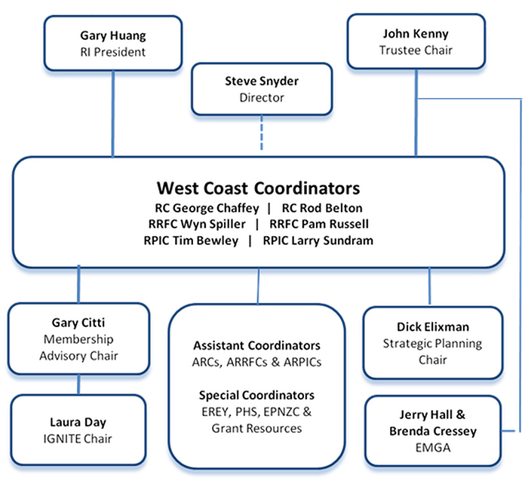

Slide 23
Structure of Rotary
Rotary Clubs
Districts
Zones
RI
35,764
529
34
1
Notes:
There are approximately 1.2 million Rotarians in the world in over 200 countries.
Rotary is the largest service organization in the world outside of the Red Cross.
The number of clubs and districts as reported by RI Support will vary from time to time. Zones are set.
Districts have a minimum of 1,100 members. Above 5,000 they may be split into two.
Typically 40-70 clubs
Zones always remain at 34 worldwide and are balanced every 8 years by total numbers as much as possible (31,000-37,000 Rotarians).
Zones serve as a training base for incoming District Governors and other District leaders. It also serves as a voting base for RI President.

Slide 24
Structure of Rotary
RI
Board
17+
John
Hewko
COL
537
TRF
John
Hewko
Chair
PRIP-5
Trustees
15
Notes:
John Hewko, Rotary International General Secretary, sits on both committees
Rotary International Board of Directors made up of the 17 International Directors (one director for two zones), plus the RI President.
Council of Legislation (COL) made up of one voted member from each district, (a PDG). It meets once every three years and votes up or down on all recommendations for changes to RI. The recommendations can be made by any Rotarian, then voted on by District. If a yes vote, then sent forth to be considered by the council.
The Rotary Foundation has 12 Trustees and is chaired by the PRIP five years after serving his term.

Slide 25
The Rotary Foundation (TRF)
Annual Programs Fund (APF)
Permanent (Endowment) Fund
Polio Plus
Notes:
The Annual Program Fund (APF) is the grant writing portion of The Rotary Foundation. The Permanent Fund is the growing endowment typically by benefactors and bequest society.
“Share”: Money donated by a district is held 3 years. Interest on three years pays most of administrative costs. After three years it is split and ½ goes to District as DDF and ½ goes to that districts “world fund” for Global Grants in the APF.

Slide 27
The Rotary Foundation
Founded in 1917 by Arch Klumph
Crippled Children/Easter Seals
100% rating by GuideStar
1 Billion plus in assets
App ¼ billion programs annually
Notes:
Global Grants: $35,000 minimum, $20K from Clubs in our District (cash and matched from District), matched with $15K from RI
Must work with another Rotary Club in another country.
District: Currently the District has broad control over management of District Designated Funds (DDF). A district can create a scholarship in any size, cover a Vocational Training Team (VTT), use for grants internationally with or without another club, and create any size limits it chooses.
Caveat: I recommend reviewing Foundation on line for greater detail and specific knowledge from District.

Slide 28
Signature Project
Notes:
The Signature Project of Rotary is to end Polio.
This effort started with a Rotary project to vaccinate children in the Philippines in 1979.
It grew to a worldwide effort supported by many.
There were approximately 358,000 cases of polio in the ’80’s.
This year that number has been reduced to just 15 in 3 endemic countries: Afghanistan, Pakistan and Nigeria.

Slide 29
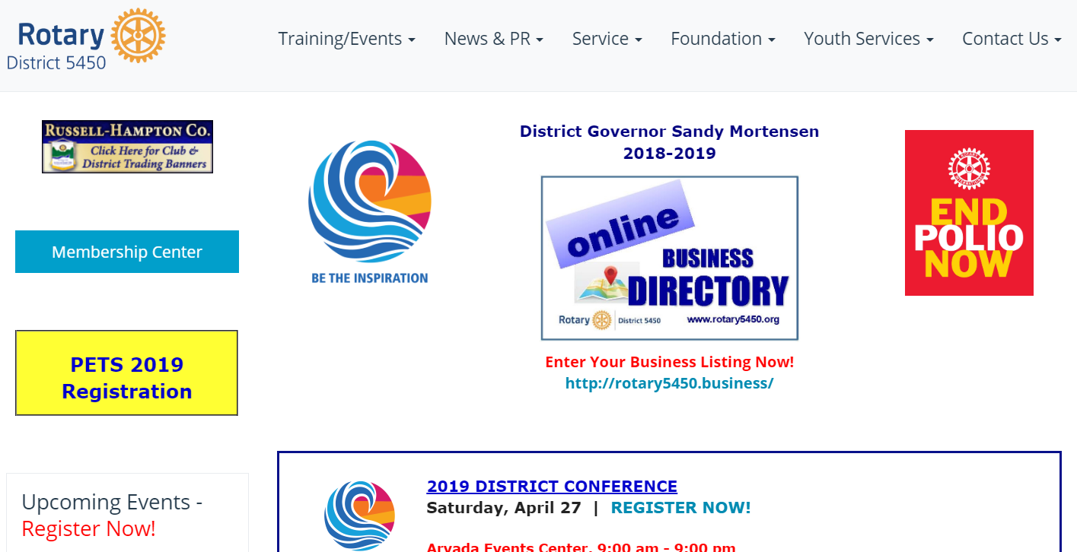
Rotary Websites

Slide 30
Rotary Leadership Institute

Slide 31
The Future of Rotary
Paul Harris, Founder of Rotary

Slide 32
2018 – 2019 Rotary Theme
Notes:
Each year the RI President picks a theme which will become theirs, and hopefully, every Rotarians guide for the Rotary year.
This upcoming year Barry Rassin picked “Be the Inspiration”.
As Barry Rassin said at the 2018 International Convention (This year in Toronto): “I ask all of you Be the Inspiration to help Rotary move from reaction to action. We want the good we do to last. We want to make the world a better place. Not just here, not just for us, but everywhere, for everyone, for generations.”

